Slide 1

“SMART ATTENDANCE ”
Attendance system using ML & DL
PROJECT BY – Vedant Gupta
Niruj Agarwal
Aditi Singh
REG.NO. –219311013
219311193
219311171
BRANCH – IOT

Slide 2
Table of Contents:
Objective
Introduction
Why this program
Methodology
Code snippets
Output snippets

Slide 3
Objective:
In today's regular life, there are many problems of common schools and colleges regarding attendance management system and its proper maintenance. So, the need of a new and improved way of tracking attendance is the need of the hour.
Main concept behind Smart Attendence is to take the attendance of students in any college or university by scanning their face and registering it in a database. Following this, the attendance of the respective person is noted down in the excel file.

Slide 4

Attendance System.
INTRODUCTION :
Face recognition is a method of identifying or verifying the identity of an individual using their face. Face recognition systems can be used to identify people in photos, video, or in real-time.
The attendance system will track student location, time of arriving/leaving. The attendance system will then process the data, to produce timesheet reports, lateness reports and absence reports.

Slide 5
WHY THIS PROGRAM:
This program helps the institute and the respective teachers to track the students’ presence in the class without any hassle and use the so-obtained data to gain insights on a respective student’s subsequent study patterns ad learning habits and willingness.
This program can furthermore help the college in tracking the number of abscences taken by a particular student in a given period of time and whether he/she had a perfectly valid reason or not.
This program reduces the risk of students getting in any improper or illegal activities inside the institute’s premises by tracking if they are in the places they are expected to be in and then can be checked where they had gone last and whether they had gotten in some questionable activities.

Slide 6
Software:
Hardware:
Python
Excel
Python libraries-
OpenCV
Pillow
Time
OS
CSV
Tkinter
Laptop
Webcam

Slide 7
Block Diagram – Workflow of Attendance System.
METHODOLOGY :
Dataset Creation
With CSV name & Rollno
Pre-processing-
Face Detection
Pre-Processing – 128-D embedding for ML
Training – ML - SVM
Load Model, LE & CSV
Pre-process frame from Camera
Classification

Slide 8
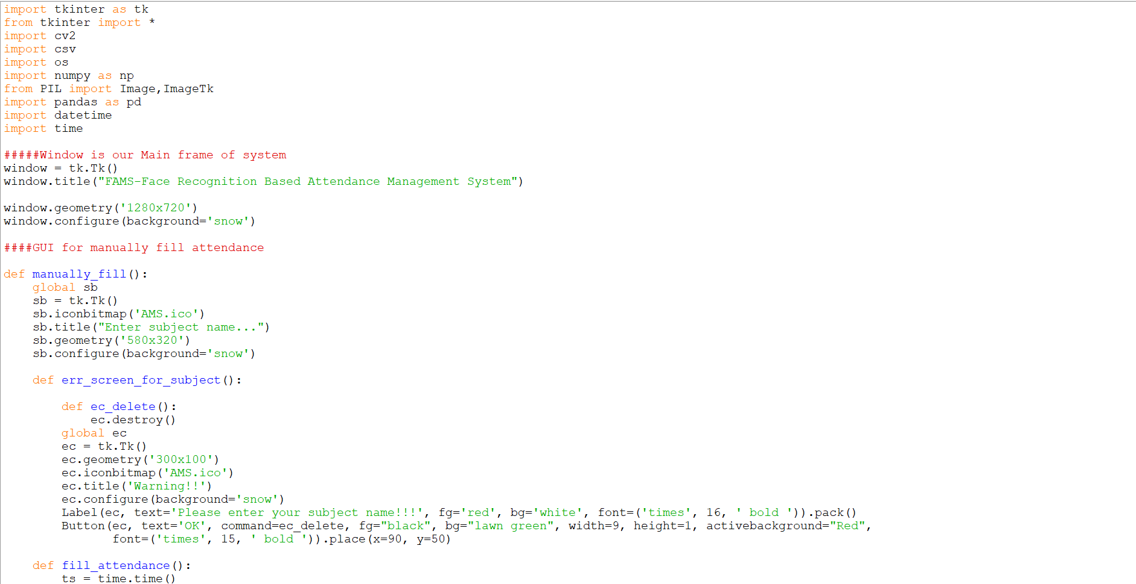
Source Code :

Slide 9
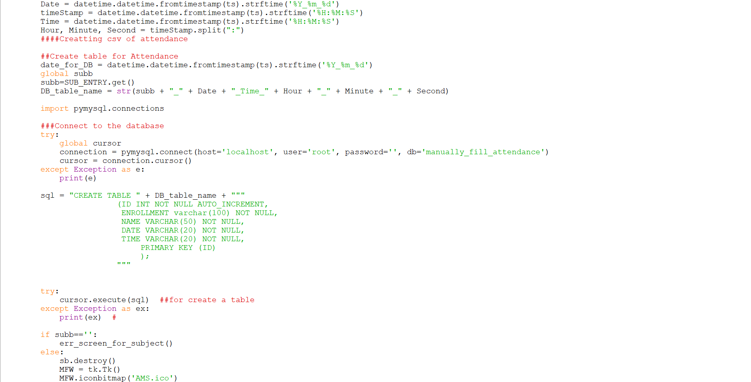
Source Code :

Slide 10
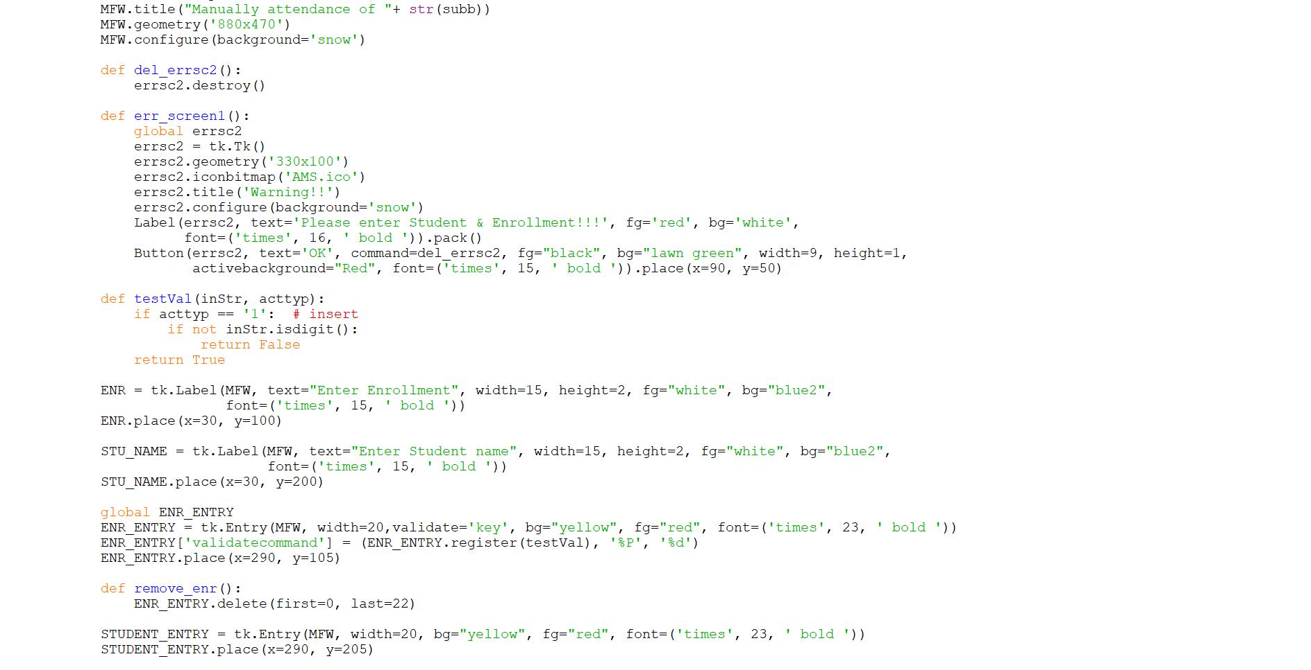
Source Code :

Slide 11
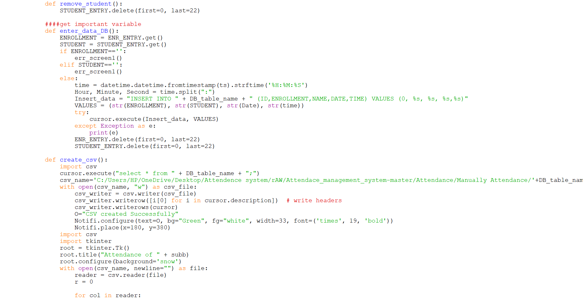
Source Code :

Slide 12
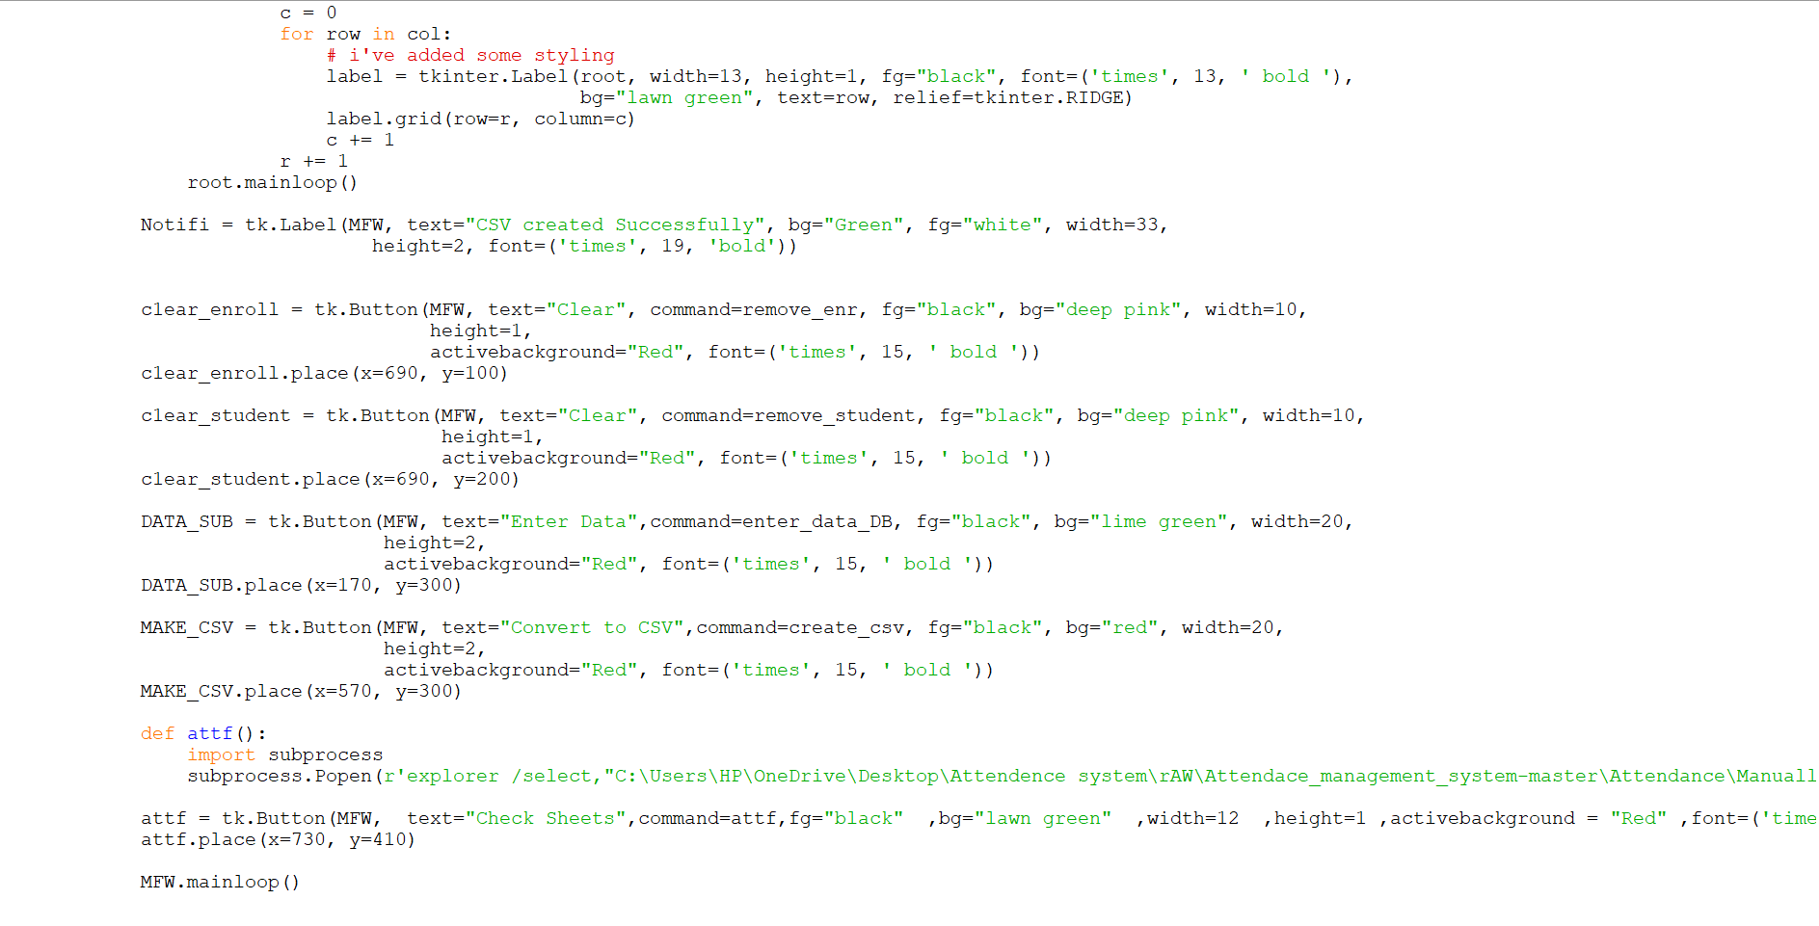
Source Code :

Slide 13
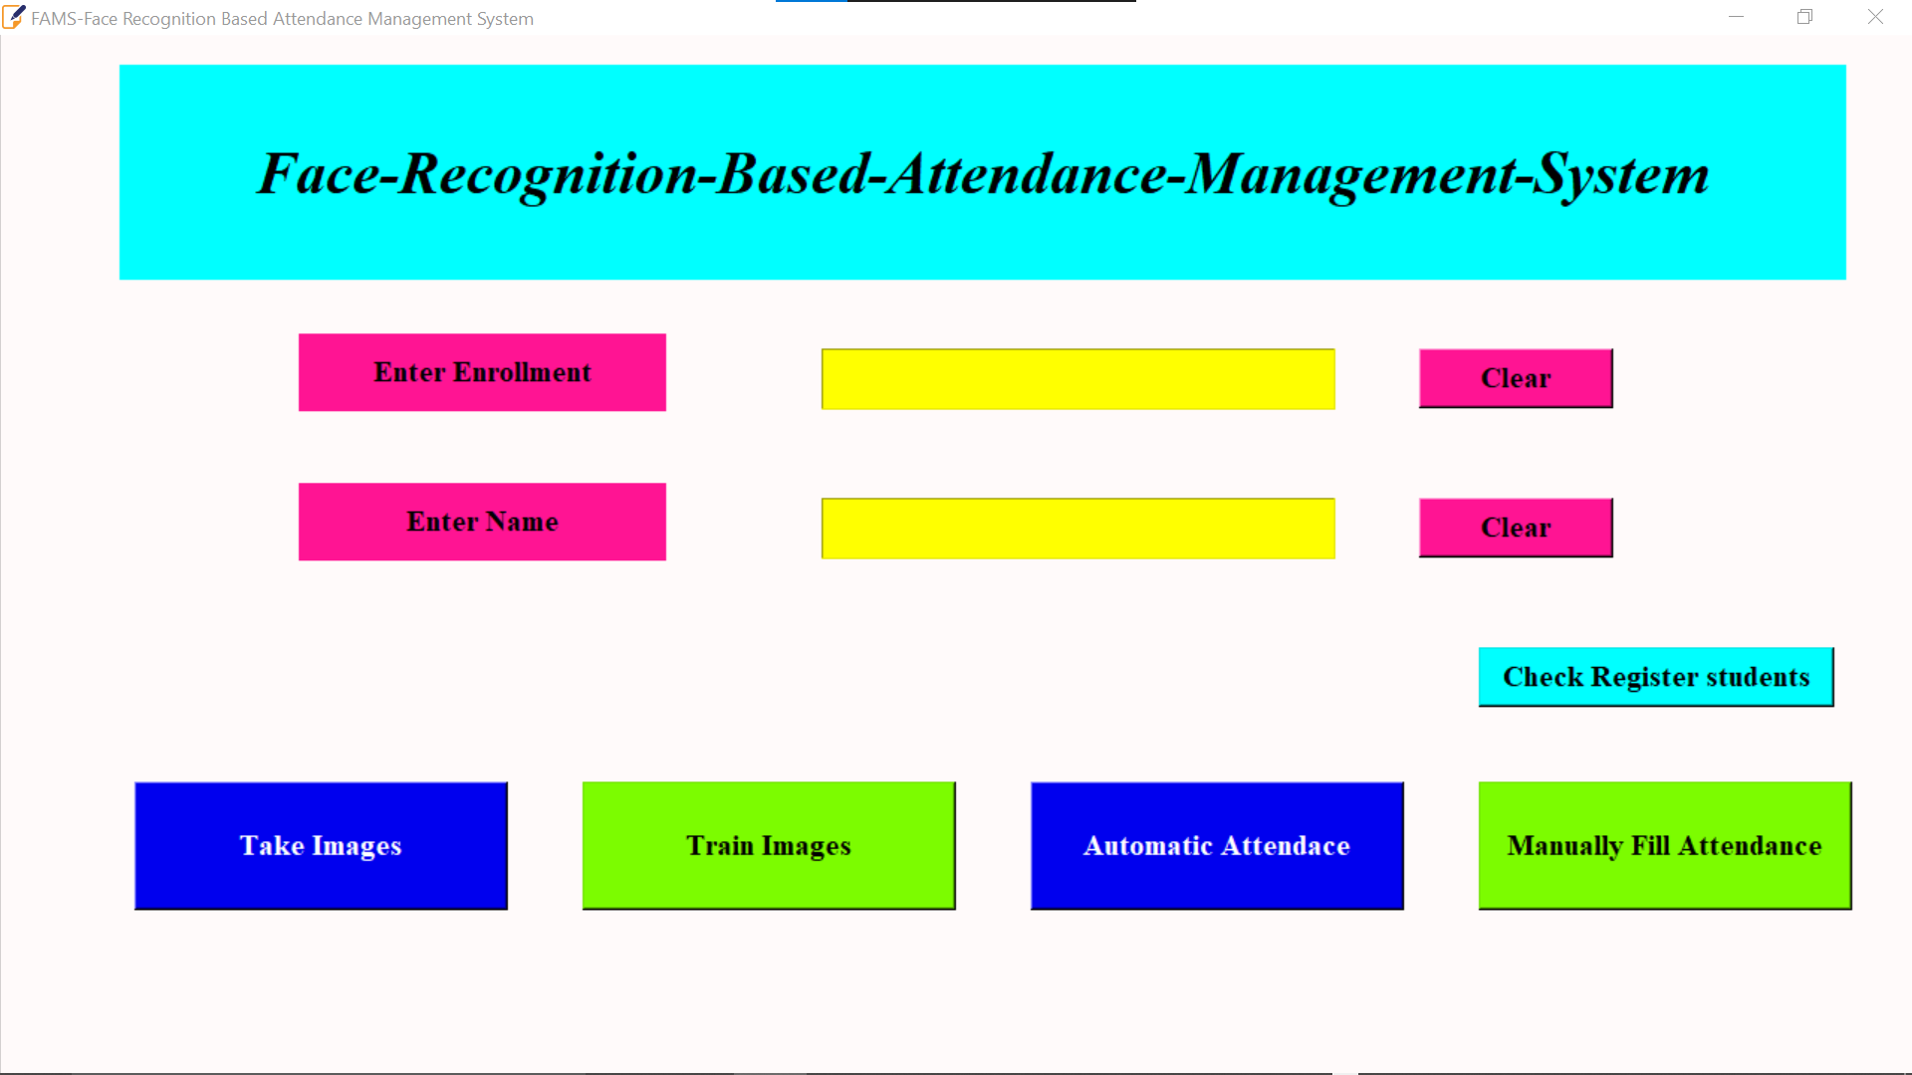

Slide 14
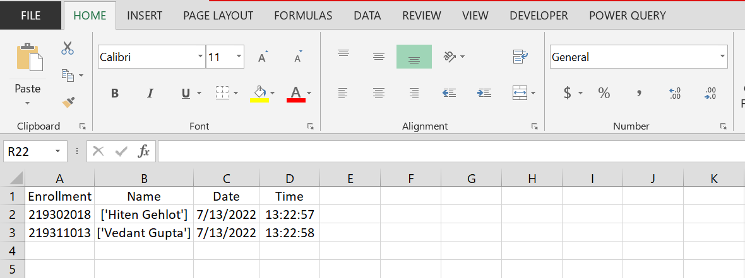

Slide 15
Conclusion :
Instead of using the conventional methods this proposed system aims to develop an automated system that can records the attendance by using facial recognisation technology . The main objective of this work was to make thr attendance marking and management system efficient , simple and easy .

Slide 16


